Slide 1
UNIT I
Structures: Introduction, types, initialization and accessing, Array of Structures, Nested Structures, Self-referential structures. Unions, enum, typedef, Dynamic Memory allocation.

Slide 2
Structure , Union and Enumerated Types
Objectives
❏ To introduce the structure, union, and enumerated types
❏ To use the type definition statement in programs
❏To create and use structures in programs
❏ To be able to use unions in programs
❏To use enumerated types

Slide 3
Derived Types

Slide 4
Structure
A structure is a collection of related elements, possibly of different types, having a single name.
DEFINITION OF STRUCTURES:
Like all data types, structures must be declared and defined.
A structure definition forms a template that may be used to create structure objects.
C has two ways to define a structure:
tagged structure and type-defined structures.

Slide 5
TAGGED STRUCTURE:
The structure definition associated with the structure name is referred as tagged structure.
It does not create an instance of a structure and does not allocate any memory.
The general form or syntax of tagged structure definition is as follows,
struct tag_name
{
type1 member1;
type2 member2;
……………
};
where struct is the keyword which tells the compiler that a structure is being defined, tag_name is the name of the structure and member1, member2 … are called members of the structure.
The members are declared within curly braces.
The closing brace must end with the semicolon.

Slide 6
Example: Student details using tagged structure
struct student
{
char name [10];
int roll_number;
float avg_marks;
}; // no memory is allocated for the structure
Memory is not reserved for the structure definition since no variables are associated with the structure definition.
The members of the structure do not occupy any memory until they are associated with the structure variables.
The declaration of the structure variable takes of the form:
struct tag_name var1, var2…;
Where, struct is the keyword, tag_name is the name of the structure.
Structure variables are separated by comma, followed by semicolon.

Slide 7
Structure variable names can be created any where in the program.
For example the variable declaration as follows:
struct student s1; // memory is allocated for the variable
Now a variable of type struct student (derived type) is created and the memory is allocated for the variable s1.
The following figure shows the memory organization for the above example s1.
10 Bytes 2 Bytes 4 Bytes

Slide 8
The number of bytes allocated for the structure variable is the sum of sizes of the individual members.
In the above example the size of s1=16 bytes (10+2+4).
You can also create structure variables in the following way:
struct tag_name
{
type1 member1;
type2 member2;
……………
}var1, var2…; //Here each variable occupies memory.
Example: Student details using structure variables.
struct student
{
char name [10];
int roll_number;
float avg_marks;
}s1; //Here memory is allocated for a variable s1.

Slide 9
We can omit the tag_name from the structure definition, the following is valid.
struct
{
char name [10];
int roll_number; float avg_marks;
} s1, s2;
Declares s1 and s2 as structure variables representing two students.
This structure definition and declaration is normally not used because we can not declare variables in later stage in the program.

Slide 10
TYPEDEFINED STRUCTURE:
The structure definition associated with keyword typedef is called type-defined structure. This is the most powerful way of defining the structure.
The syntax of typedefined structure is:
typedef struct
{
type1 member1;
type2 member2;
……
} TYPE_ID;
Where, typedef is keyword added to the beginning of the definition, struct is the keyword which tells the compiler that a structure is being defined and member1, member2…are called fields of the structure.
The closing brace must end with type definition name which in turn ends with semicolon.

Slide 11
Example: Student details
typedef struct /*Structure Definition*/
{
char name [10];
int roll_number;
float avg_marks;
} STUDENT; //no memory is allocated for structure
/*Structure Declaration*/
STUDENT s1, s2; //memory is allocated for the variables
Note: Using typedef it is not possible to declare a variable. But, we can have user defined data type. TYPE_ID can be treated as the new data type.

Slide 12
Structure Declaration Format

Slide 13
INITIALIZATION OF STRUCTURES:
The rules for structure initialization are similar to the rules for array initialization.
The initializers are enclosed in braces and separate by commas.
They must match their corresponding types in the structure definition.
The syntax is shown below:
struct tag_name variable = {value1, value2,… valuen};
Structure initialization can be done in any of the following initializations.
Initialization along with Structure definition
Consider the structure definition for student with three fields name, roll number and average marks. The initialization of variable can be done as shown below:
struct student
{
char name [5];
int roll_number;
float avg;
} s1= {“Ravi”, 10, 67.8};

Slide 14
Initialization during Structure declaration:
Consider the structure definition for student with three fields name, roll number and average marks. The initialization of variable can be done as shown below,
struct student
{
char name[5];
int roll_number;
float avg;
};
struct student s1= {“Ravi”, 10, 67.8};

Slide 15
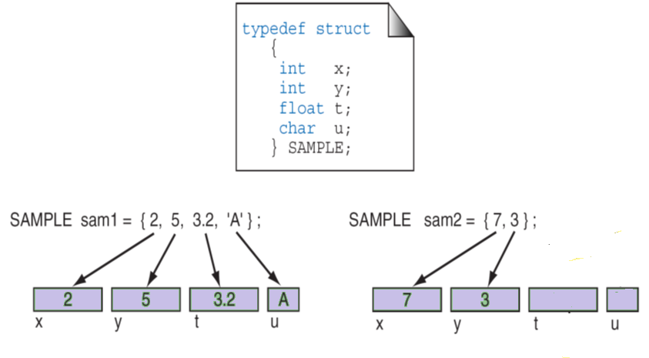
Initializing Structures

Slide 16
Points to Remember:
The members of the structure cannot be initialized in the structure definition.
For example,
struct s
{
char name [10] ="ravi”;
int rno;
} s1; //It is invalid.
The initial values are assigned to members of the structure on one-to-one basis i.e., the values are assigned to various members in the order specified from the first member.
For example,
s1= {“ravi”, 60, 56.7};
is valid. Here, the string “ravi” will be assigned to the first member, 60 is assigned to the second member and 56.7 is assigned to the third member.

Slide 17
However the statement, s1= {40, 67.8};
is invalid, because, without initializing the first member name, we are trying to initialize last two members.
During initialization, the number of initializers should not exceed the number of members. It leads to syntax error.
For example, s1= {“ravi”, 45, 78.9, 89};
The compiler issues a syntax error “too many initializers”

Slide 18
ACCESSING STRUCTURES:
The members of a structure can be accessed by using dot(.) operator.
Before dot, there must always be a structure variable.
After the dot, there must always be a structure member.
The syntax to access the structure members as follows:
structure_variable_name. structure_member_name
For example, consider the example as shown below,
struct student
{
char name [5];
int roll_number;
float avg;
};
struct student s1= {“Ravi”, 10, 67.8};
The members can be accessed using the variables as shown below:
s1.name //refers the string “ravi”
s1.roll_number //refers the roll_number 10
s1.avg //refers avg 67.8

Slide 19
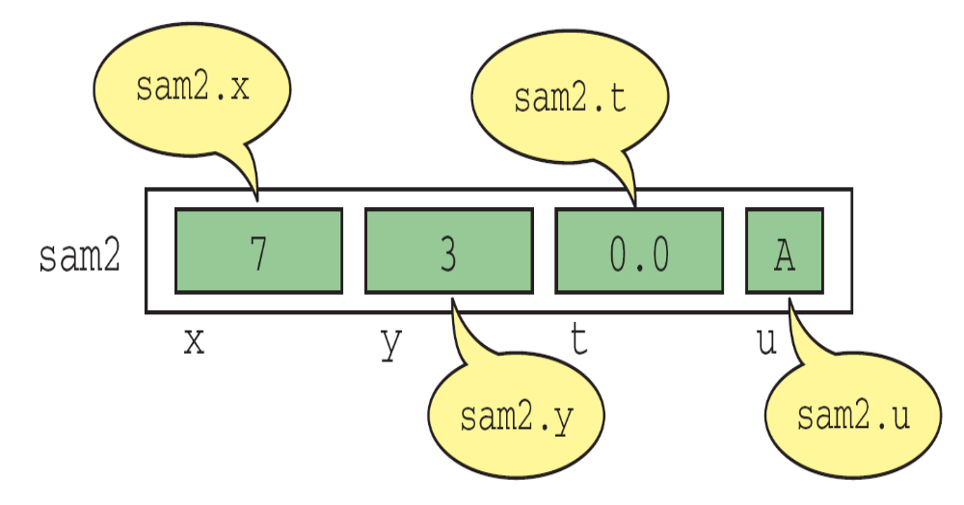
Structure Direct Selection Operator

Slide 20
#include<stdio.h>
struct student
{
int rollno;
char name[20];
};
main() {
struct student s1 = {1222,”IT"};
printf("\n%d %s",s1.rollno,s1.name);
}
#include<stdio.h>
typedef struct
{
int rollno;
char name[20];
}student;
main() {
student s1 = {1222,”IT"};
printf("\n%d %s",s1.rollno,s1.name);
}
#include<stdio.h>
struct student
{
int rollno;
char name[20];
}s1;
main() {
s1.rollno = 1222;
gets(s1.name);
printf("\n%d %s",s1.rollno,s1.name);
}

Slide 21
Structures initialization and access members
#include <stdio.h>
struct stud
{
char name[15];
int rno;
float avg;
};
struct stud s1={“IT”,10,90};
void main()
{
printf(“student details are”);
printf(“name=%s \n rno=%d\n avg=%f”,s1.name,s1.rno,s1.avg);
}
#include <stdio.h>
struct stud
{
char name[15];
int rno;
float avg;
};
void main()
{
struct stud s1={“IT”,10,90};
struct stud s2;
s2.name=“it”;
s2.rno=15;
s2.avg=90;
printf(“student details are”);
printf(“name=%s \n no=%d\n avg=%f”,s1.name,s1.rno,
s1.avg);
}
#include <stdio.h>
struct stud
{
char name[15];
int rno;
float avg;
}s1={“IT”,10,80};
void main()
{
printf(“student details are”);
printf(“name=%s\n rno= %d \n avg=%f”,s1.name,s1.rno,s1.avg);
}

Slide 22
Reading values from keyboard
#include<stdio.h>
struct stud
{
char name[15];
int rno;
float avg;
};
void main()
{
struct stud s1;
printf(“enter student name ,rno and avg”);
scanf(“%s%d%f”,s1.name,&s1.rno,&s1.avg);
printf(“student details:”);
printf(“name=%s”\n rno=%d\n avg=%f”,s1.name,s1.rno,s1.avg);
}

Slide 23
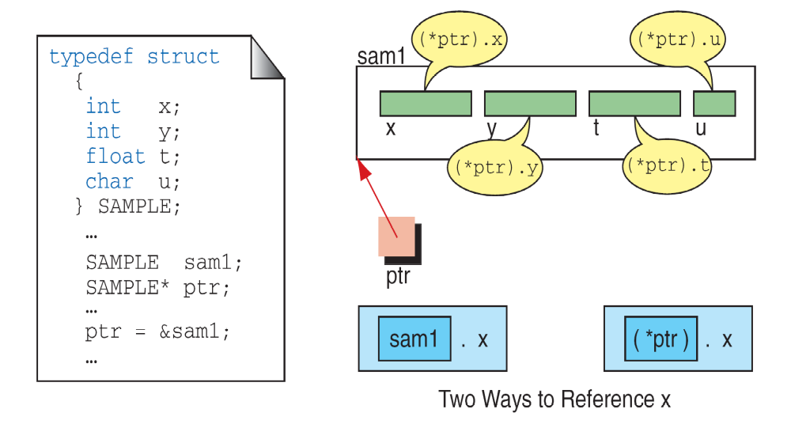
(*pointerName).fieldName ↔ pointerName⁻>fieldName
Pointers to Structures

Slide 24
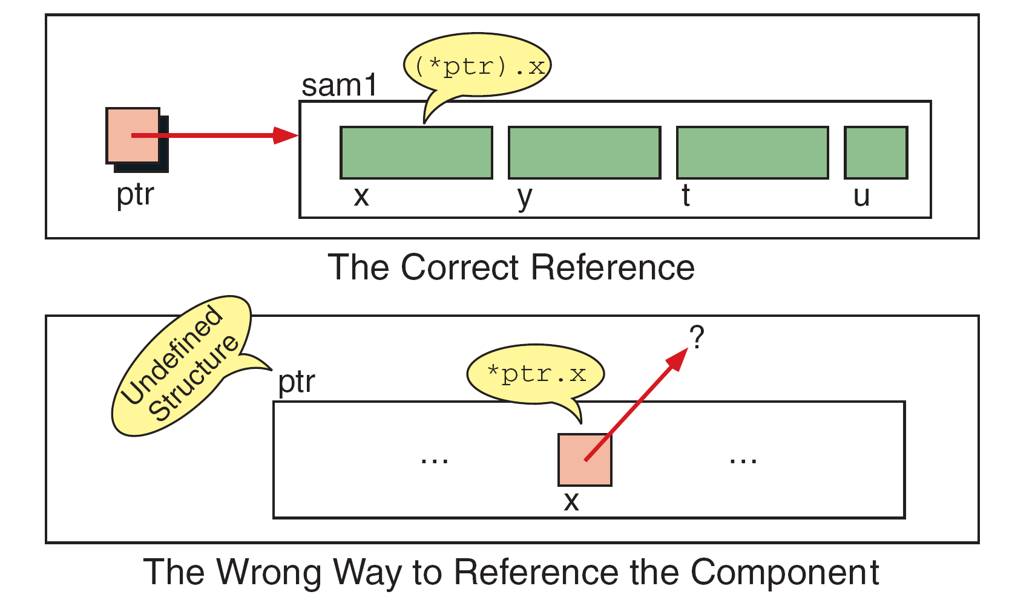
Interpretation of Invalid Pointer Use

Slide 25
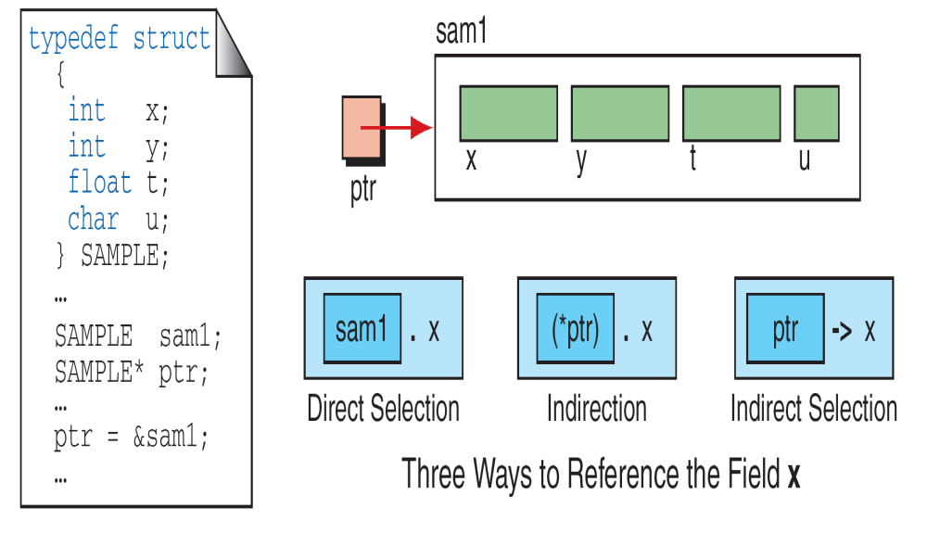
Indirect Selection Operator

Slide 26
Pointer to structures
#include<stdio.h>
struct stud
{
char name[15];
int rno;
float avg;
};
void main()
{
struct stud s1,*p;
p=&s1;
printf(“enter student name ,rno and avg”);
scanf(“%s%d%f”,s1.name,&s1.rno,&s1.avg);
Printf(student details:”);
printf(“name=%s”\n rno=%d\n avg=%f”,(*p).name,(*p).rno,(*p).avg);
printf(“name=%s”\n rno=%d\n avg=%f”,p->name,p->rno,p->avg);
}

Slide 27
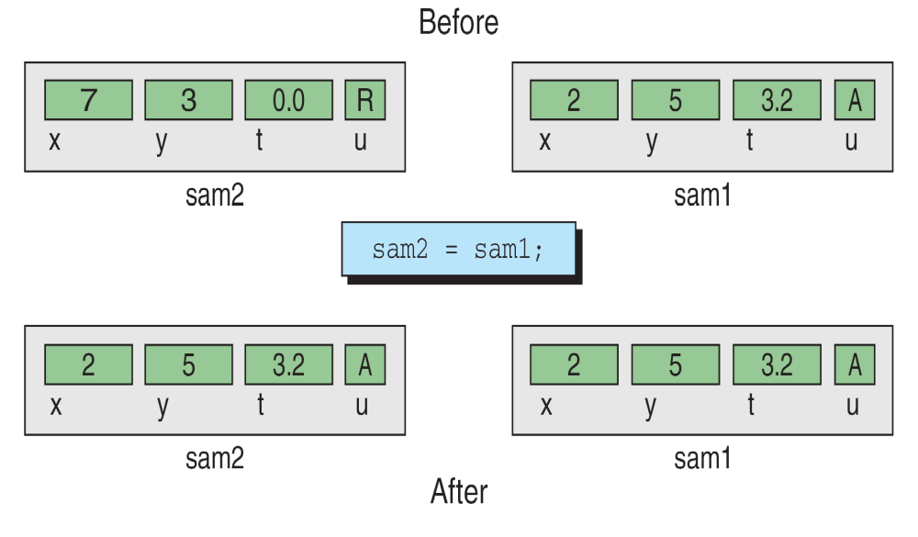
Copying a Structure

Slide 28
Assign one stucture variable to another
#include<stdio.h>
struct stud
{
char name[15];
int rno;
float avg;
};
void main()
{
struct stud s1,s2;
printf(“enter student name ,rno and avg”);
scanf(“%s%d%f”,s1.name,&s1.rno,&s1.avg);
s2=s1;
printf(student details:”);
printf(“name=%s”\n rno=%d\n avg=%f”,s2.name,s2.rno,s2.avg);
}

Slide 29
Arrays with in structures:
It is also possible to declare an array as a member of structure, like declaring ordinary variables.
For example to store marks of a student in three subjects then we can have the following definition of a structure.
struct student
{
char name [5];
int roll_number;
int marks [3];
float avg;
};
Then the initialization of the array marks done as follows,
struct student s1= {“ravi”, 34, {60,70,80}};
The values of the member marks array are referred as follows,
s1.marks [0] will refer the 0th element in the marks
s1.marks [1] will refer the 1st element in the marks
s1.marks [2] will refer the 2ndt element in the marks

Slide 30
ARRAY with in structures
#include<stdio.h>
struct stud
{
char name[15];
int rno;
int m[6];
float avg;
};
void main()
{
struct stud s1;
int i,sum=0;
printf(“enter student name ,rno ”);
scanf(“%s%d”,s1.name,&s1.rno,);
printf(“enter student marks”);
for(i=0;i<6;i++)
{
scanf(“%d”,&s1.m[i]);
sum+=s1.m[i];
}
s1.avg=sum/6;
printf(student details:”);
printf(“name=%s \ n rno=%d \n avg=%f”,s1.name,s1.rno,s1.avg);
}

Slide 31
ARRAY OF STRUCTURES:
We can also create array of structures. Array of structures can be declared as follows:
struct tag_name array_name[size];
Let’s take an example, to store the information of 3 students, we can have the following structure definition and declaration,
struct student
{
char name[10];
int rno;
float avg;
};
struct student s[3];

Slide 32
The above code defines an array called s, which contains three elements. Each element is defined to be of type struct student.
For the student details, array of structures can be initialized as follows,
struct student s[3] = {
{“ABC”, 1, 56.7},
{“xyz”, 2, 65.8},
{“pqr”, 3, 82.4}
};

Slide 33
ARRAY of structures
#include<stdio.h>
struct stud
{
char name[15];
int rno;
int m[6];
float avg;
};
void main()
{
struct stud s[3];
int i,j ,sum=0
for(i=1;i<=3;i++)
{
sum=0;
printf(“enter student %d name ,rno ”,i);
scanf(“%s%d”,s[i].name,&s[i].rno);
printf(“enter student %d marks”,i);
for(j=0;j<6;j++)
{
scanf(“%d”,&s[i].m[j]);
sum+=s[i].m[j];
}
s[i].avg=sum/6;
printf(student details:”);
printf(“name=%s \ n rno=%d \n avg=%f”,s[i].name,s[i].rno,s[i].avg);
}
}

Slide 34
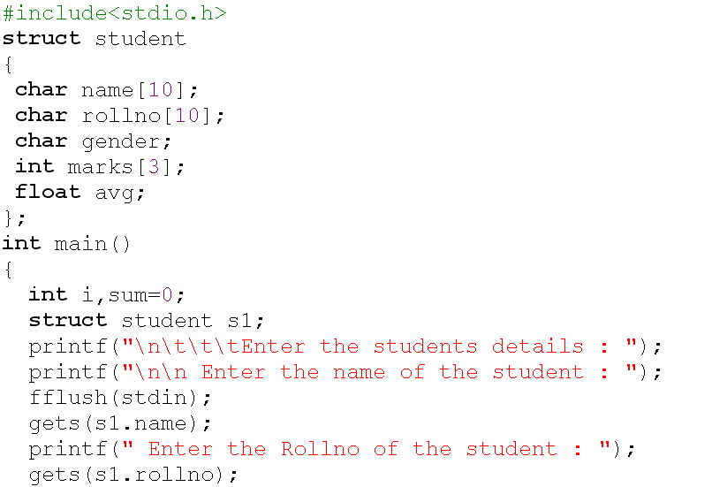

Slide 35
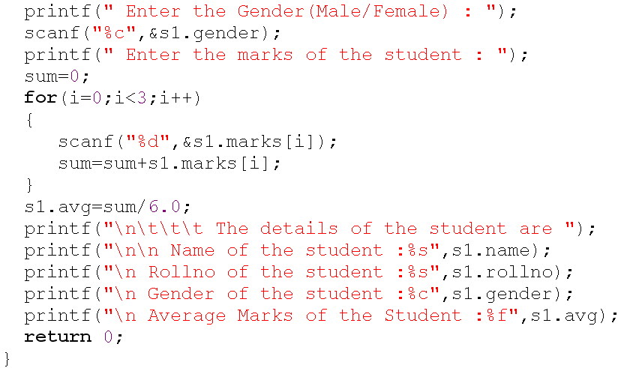

Slide 36
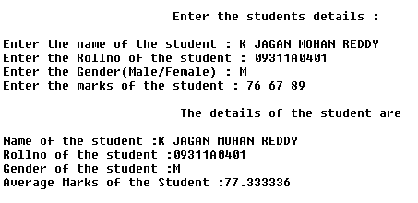

Slide 37
Nested Structures:
A structure which includes another structure is called nested structure.
The syntax for the nesting of the structure as follows:
struct tag_name1
{
type1 member1;
…….
…….
};
struct tag_name2
{
type1 member1;
……
……
struct tag_name1 var;
……
};
The syntax for accessing members of a nested structure as follows,
outer_structure_variable.inner_structure_variable.membername

Slide 38
Example:
struct data
{
int day;
int month;
int year;
};
struct student
{
char name [10];
int roll_number;
struct data dob;
int marks [3];
float avg;
} s1;
The members contained in the inner structure namely day, month and year can be referred to as
s1.dob.day
s1.dob.month
s1.dob.year

Slide 39
Nested Structures
#include<stdio.h>
struct data
{
int day;
int month;
int year;
};
struct s tud
{
char name [10];
int rno;
struct data dob;
float avg;
} s1;
main()
{
printf(“enter student name ,rno and avg”);
scanf(“%s%d%f”,s1.name,&s1.rno,&s1.avg);
s1.dob.day=12;
s1.dob.month=3;
s1.dob.year=1995;
Printf(student details:”);
printf(“name=%s”\n rno=%d\n avg=%f \n”,s1.name,s1.rno,s1.avg);
}

Slide 40
Structures with functions
#include<stdio.h>
struct student
{
int rollno;
char name[20];
float avg;
}s1;
void display(struct student);
void main()
{
printf(“enter student name ,rno and avg”);
scanf(“%s%d%f”,s1.name,&s1.rno,&s1.avg);
display(s1);
}
void display(struct student s2)
{
printf("%s%d %f",s2.name,s2.rno,s2,avg);
}

Slide 41
SELF-REFERENTIAL STRUCTURE
A structure definition which includes at least one member as a pointer to the same structure is known as self-referential structure.
It can be linked together to form useful data structures such as lists, queues, stacks and trees.
Terminated with a NULL pointer (0).
The syntax for using the self referential structure as follows,
struct tag_name
{
type1 member1;
type2 member2;
….
struct tag_name *next;
};

Slide 42
UNIONS:
A union is one of the derived data type.
Union is a collection of variables referred under a single name.
The syntax, declaration and use of union is similar to the structure but its functionality is different.
The major distinction between structure and union is, in terms of storage.
In structure each member has its own storage location, whereas all the members of a union use the same location.
Although a union may contain many members of different types, it can handle only one member at a time.

Slide 43
The general format or syntax of a union definition is as follows,
union tag_name
{
type1 member1;
type2 member2;
……..
};
The compiler allocates a piece of storage that is large enough to hold the largest variable type in the union.
A union variable can be declared same way as structure variable.
union tag_name var1, var2...;

Slide 44
A union definition and variable declaration can be done by using
any one on the following:
union u
{
char c;
int i;
float f;
};
union u a;
typedef union
{
char c;
int i;
float f;
} U;
U a;
union u
{
char c;
int i;
float f;
} a;
tagged union variable union typedef union

Slide 45
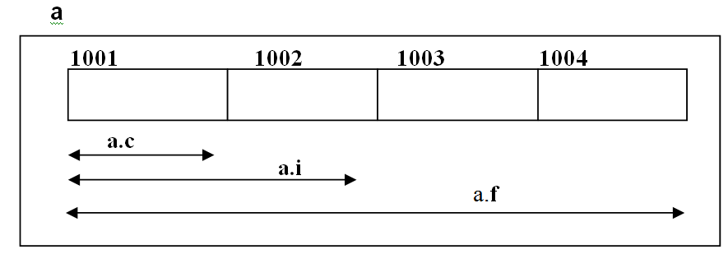
To access the members of union, the same syntax used to access various members of a structure can be used, by using the dot operator (“. “).
For above example, we can access various members of the union as shown below,
a.c a.i a.f
For the above example, union contains three members, each with a different data type. However, we can use only one of them at a time.

Slide 46
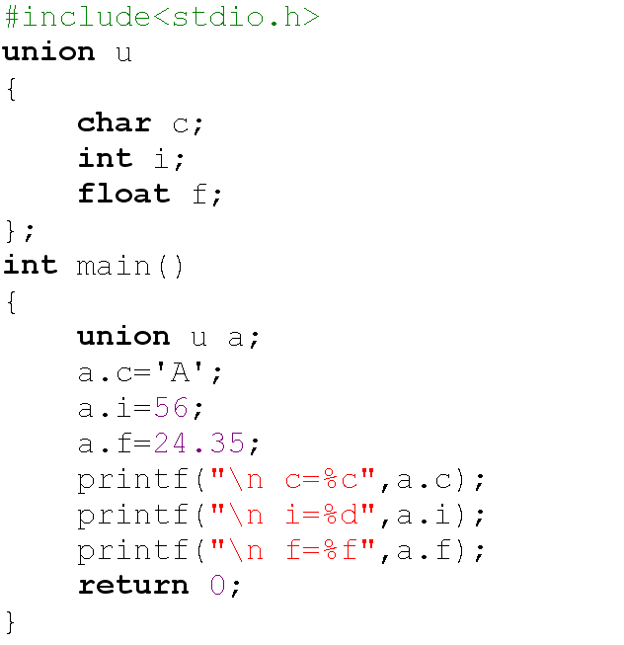


Slide 47
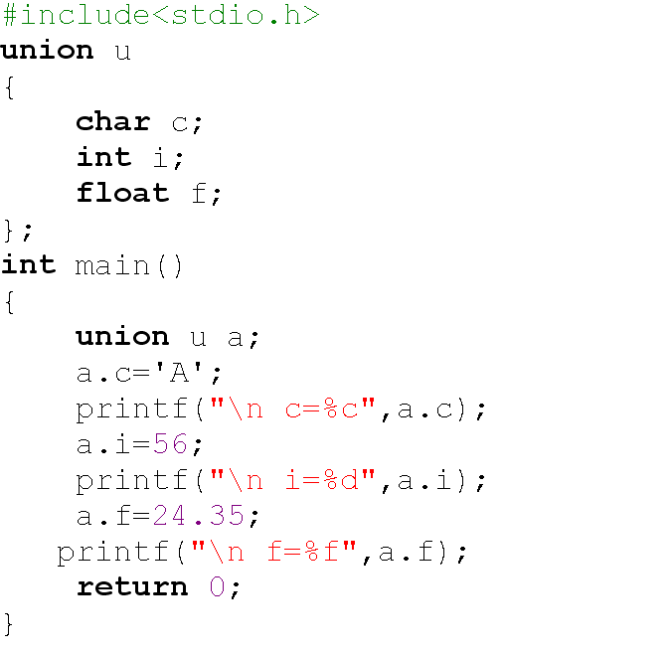


Slide 48
 | Arrays | Structures | Unions
Keyword | … | struct | union
Definition | An array is a homogeneous collection of data. | A structure is a collection of logically related elements, possibly of different types, having a single name. | A union is a collection of logically related elements, possibly of different types, having a single name, shares single memory location.
Declaration | data_type array_Name[size]; | struct tag_name { type1 member1; type1 member2; …………… …………… }; struct tag_name var; | union tag_name { type1 member1; type1 member2; …………… …………… }; union tag_name var;
Initialization | Done by separating list of values with comma (,), specified in Curly braces { }. | Same. | Same.
Accessing | Accessed by specifying array name with subscript | Accessed by specifying structure variablename. membername | Accessed by specifying union variablename. membername

Slide 49
Memory Allocation | Each array element occupies memory, stored in contigenous locations. | Each member of the structure occupies unique location, stored in contigenous locations. | Memory is allocated by considering the size of largest member. All the members share the common location
Size | Size of the array is depending on the array type and size. sizeof (arr); | Size of the structure depends on the type of members, adding size of all members. sizeof (st_var); | Size is given by the size of largest member storage. sizeof(un_variable);
Using pointers | An array elements values can be accessed by using de-referencing operator(*) | Structure members can be accessed by using de-referencing dot operator and selection operator(->) | Same as structure.
 | We can have array of structures or unions. here the array type is structure or union. | We can have arrays as a member of structures. | We can have array as a member of union.
 | All elements can be accessed at a time | All members can be accessed at a time | Only one member can be accessed at a time.

Slide 50
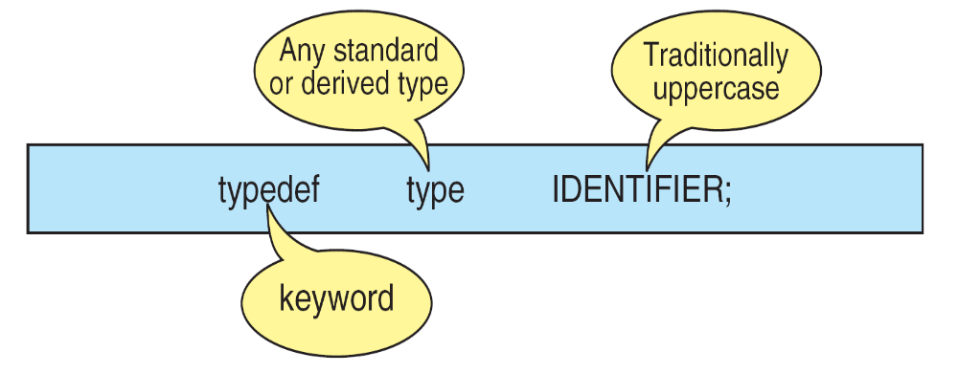
The Type Definition (typedef)
A type definition, typedef, gives a name to a data type by creating a new type that can then be used anywhere a type is permitted.
Its purpose is to redefine the name of an existing variable type.
Type-definition Format

Slide 51
The general syntax of the typedef is as follows,
typedef data_type IDENTIFIER;
where typedef is the keyword that tells the compiler about the type definition, data_type refers to an existing data type and IDENTIFIER refers the “new” name given to the data type.
Note that using typedef, we are not creating new data types.
Instead we are creating only new name for the existing data type.
These new data type names are called user-defined data types.

Slide 52
Suppose we want to store marks scored in various subjects in variables sub1, sub2 and sub3. These variables can be declared as follows,
int sub1, sub2, sub3;
Using the user-defined data types, the variables can be declared as shown below,
typedef int MARKS;
MARKS sub1, sub2, sub3;

Slide 53
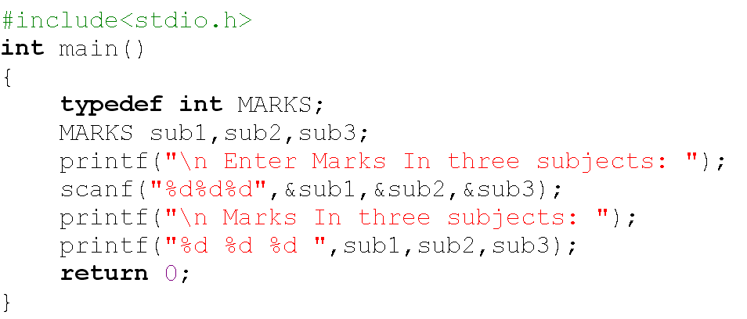
//Example program to demonstrate typedef

Slide 54
Enumerated Types
The enumerated type is a user-defined type based on the standard integer type.
In an enumerated type, each integer value is given an identifier called an enumeration constant.

Slide 55
Declaring an Enumerated Type:
To declare an enumerated type, we must declare its identifier and its values. Because it is derived from integer type, its operations are the same as for integers.
Syntax for defining an enumerated type is as follows,
enum type_Name
{
member1;
member2;
….
….
};

Slide 56
Where enum is the keyword that tells the compiler about enumerated type definition, enum type_Name together represent the user defined data type and member1, member2… are integer constants but represented using descriptive names. These are called enumerator constants or enumerators.
The definition is terminated with a semicolon.
The syntax for declaring the variables are shown below:
enum type_Name var;

Slide 57
Following are some of the examples of enumerator type:
enum color
{
RED,
BLUE,
GREEN
};
enum color c1, c2;
enum days
{
SUNDAY,
MONDAY,
…
SATURDAY
} d1;

Slide 58
Assigning Values to Enumerated Types
After an enumerated variable has been declared, we can store values in it.
While, the compiler automatically assigns values to enumerated types starting with 0, the next values are initialized with a value by adding 1 to previous value.
For example,
enum color {RED, BLUE, GREEN, WHITE};
Here red representing the value 0, blue is 1, green is 2, white is 3.
You can also create variables from the enumerated type.
For example, enum color skyColor;

Slide 59
We can override it and assign our own values.
For example, to make JAN start with 1 we could use the following declaration.
enum month
{
JAN=1, FEB, MAR, APR, MAY,JUN, JUL, AUG, SEP, OCT, NOV, DEC
}m1;
Note that we need not to assign every enumerator constant value. If we omit the initializes, the complier assigns the next value by adding 1.
Consider the following enumerated declaration,
enum days
{
sun=3, mon, tue, wed=0, thu, fri, sat
} d1, d2;

Slide 60
//Example program to demonstrate enum
#include<stdio.h>
main()
{
enum color
{
RED,
GREEN,
BLUE
}c1;
printf("%d %d %d",RED,GREEN,BLUE);
c1 = BLUE;
printf("\n%d ",c1);
}
Output:
0 1 2
2

Slide 62
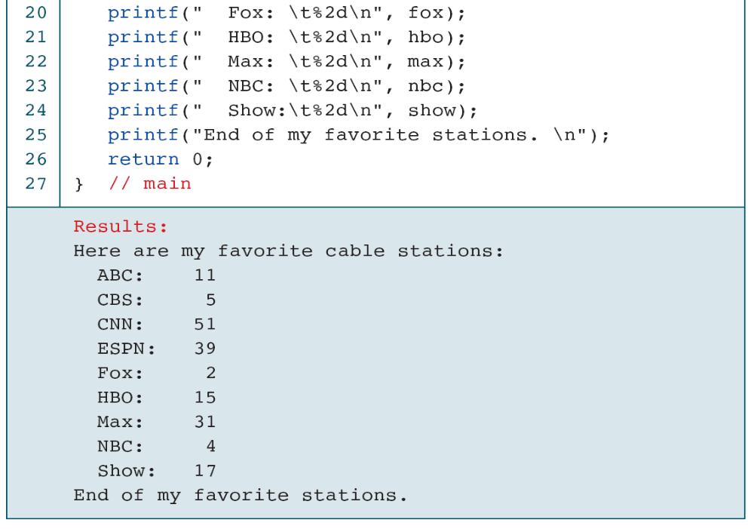

Slide 63
Dynamic Memory Allocation Functions
C gives us two choices when we want to reserve memory locations for an object:
static allocation and dynamic allocation.
Memory Usage
Static Memory Allocation
Dynamic Memory Allocation
Memory Allocation Functions
Releasing Memory (free)

Slide 64
Memory Allocation

Slide 65
Conceptually memory is divided into program memory and data
memory.
Program memory consists of the memory used for main and all called functions.
Data memory consists of permanent definitions, such as global data and constants, local declarations, and dynamic data memory.
All functions, local and global data can be stored in stack memory.
Heap memory is unused memory allocation known as the heap is available to be assigned during its execution.
It is the memory pool from which memory is allocated when requested by the memory allocation functions.

Slide 66
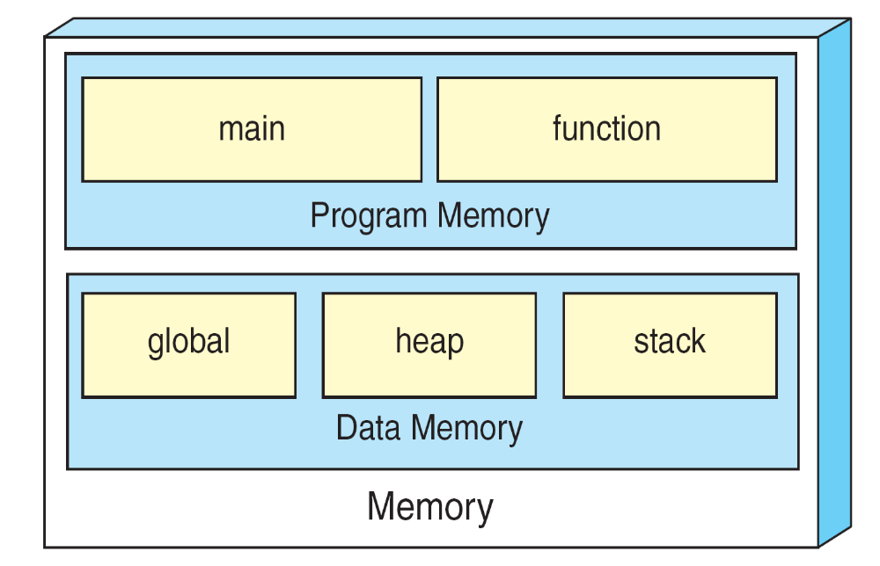
We can refer to memory allocated in the heap only
through a pointer.
A Conceptual View of Memory

Slide 67
Static Memory Allocation requires that the declaration and definition of memory be fully specified in the source program.
The number bytes reserved can not be changed during run time.
Dynamic Memory Allocation uses predefined functions to allocate and release memory for data while the program is running.
Unlike static memory allocation, dynamic memory allocation has no identifier associated with it; it has only an address that must be used to access it.
To access data in dynamic memory therefore, we must use a pointer.

Slide 68
Accessing Dynamic Memory

Slide 69
Memory Allocation Functions:
Four memory management functions are used with dynamic memory.
Three of them, malloc, calloc, and realloc, are used for memory allocation.
The fourth, is used to return memory when it is no longer needed.
All the memory management functions are found in the standard library file stdlib.h

Slide 70
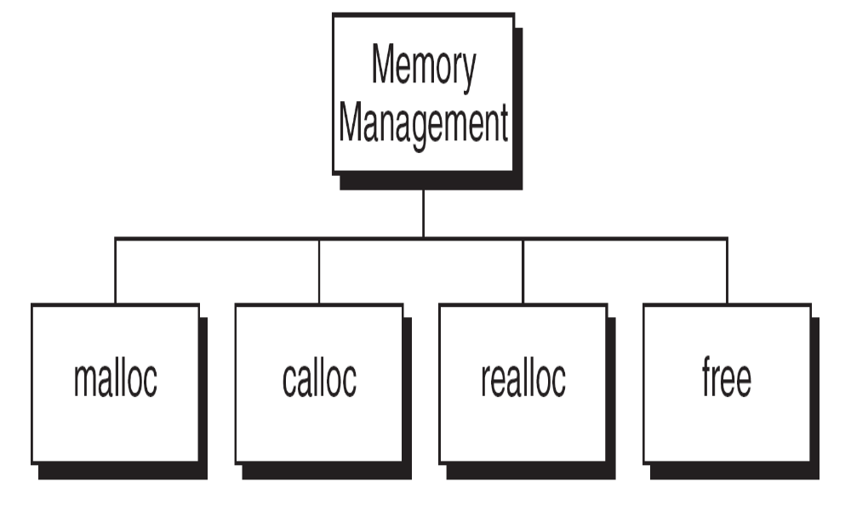
Memory Management Functions

Slide 71
Block Memory Allocation ( malloc )
The malloc function allocates a block of memory that contains the number of bytes specified in its parameter.
It returns a pointer of type void to the first byte of the allocated memory, even the allocated memory is not initialized.
The malloc function declaration is shown below:
void* malloc (size_t size);
The type, size_t, is defined in several header files including stdio.h
The type is usually an unsigned integer.
The size specification in malloc’s actual parameter is generally computed using the sizeof operator.

Slide 72
Block Memory Allocation ( malloc ) Contd…
For example, if we want to allocate an integer in the heap, we code the call as shown below:
pInt = malloc(sizeof(int));
If successful, malloc returns the address of the first byte in the memory space allocated.
However, if it is not successful, malloc returns NULL pointer.
Never call malloc with a zero size, result is unpredictable.
Memory allocation casting:
pointer_name = (type*) malloc(size);
An attempt to allocate memory from the heap when memory is insufficient is known as overflow.

Slide 73
malloc

Slide 74
Continuous Memory Allocation ( calloc ) Contd…
The calloc function is primarily used to allocate memory for arrays.
It differs from malloc only in that it sets memory to null characters.
The calloc function declaration is shown below.
void *calloc(size_t element-count, size_t element-size);
The result is the same for both malloc and calloc when overflow occurs and when a zero size is given.

Slide 75
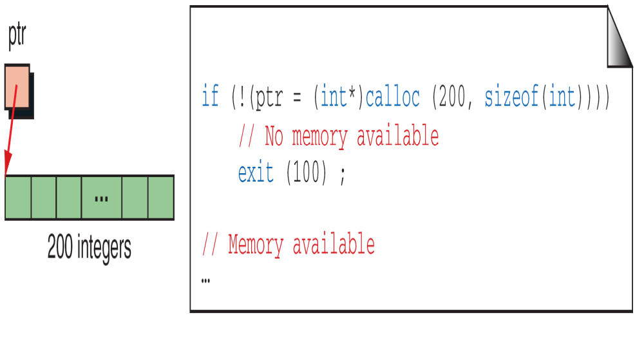
The following example creates memory for an array of 200 integers.
calloc

Slide 76
Reallocation of Memory( realloc )
The realloc function can be highly inefficient and therefore should be used advisedly.
When given a pointer to a previously allocated block of memory, realloc changes the size of the block by deleting or extending the memory at the end of the block.
If the memory can not be extended because of the other allocations, realloc allocates a completely new block, copies the existing memory allocation to the new allocation, and deletes the old allocation.
The programmer must ensure that any other pointers to the data are correctly changed.
The operation of realloc is shown below:
void *realloc (void* ptr, size_t new Size);

Slide 77
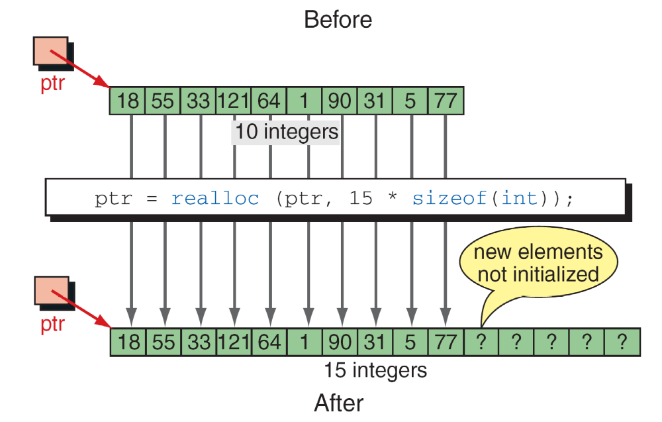
realloc

Slide 78
Releasing of memory (free)
When memory locations are allocated by malloc, calloc, or realloc are no longer needed, they should be frees using the predefined function free.
It is an error to free memory with a null pointer.
It is also a potential error to refer to memory after it has been released.
The function declaration statement fo free is shown below:
void free (void* ptr);

Slide 79
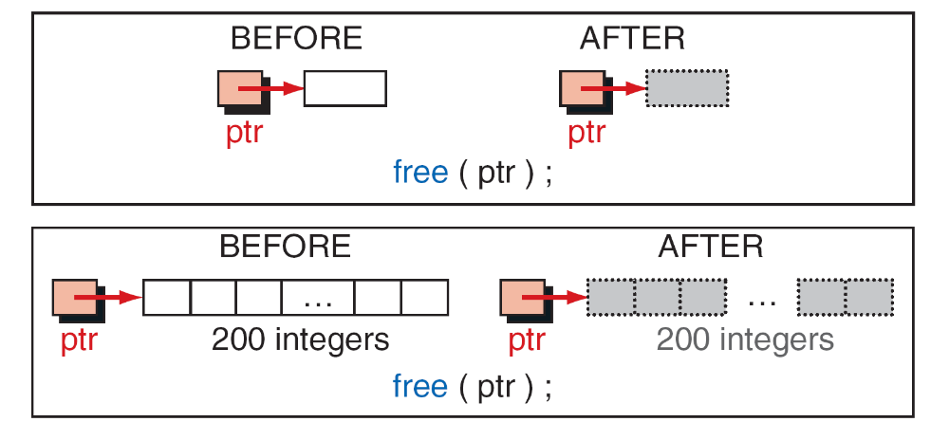
The first one releases a single element, allocated with malloc, back to heap and second one releases 200 elements (allocated with calloc) back to heap.
Note: It is not the pointers that are being released but rather what they point to.
Freeing Memory

Slide 80
Note
Using a pointer after its memory has been released is a common programming error. Guard against it
by clearing the pointer.
The pointer used to free memory must be of the same type as the pointer used to allocate the memory.

Slide 81
Malloc
The name malloc stands for memory allocation.
malloc() takes one argument i.e, number of bytes.
malloc() does not initialize the allocated memory
syntax of malloc():
void *malloc(size_t n);
Allocates n bytes of memory. If the allocation succeeds, a void pointer to the allocated memory is returned. Otherwise NULL is returned.
malloc is faster than calloc
Calloc
The name calloc stands for contiguous allocation.
calloc() takess two arguments.
calloc() initializes the allocated memory to ZERO
syntax of calloc():
void *calloc(size_t n, size_t size);
Allocates a contiguous block of memory large enough to hold n elements of size bytes each. The allocated region is initialized to zero.
calloc takes little longer than malloc because of the extra step of initializing the allocated memory by zero. However, in practice the difference in speed is very tiny and not recognizable.

Slide 82
Read and print variables using Malloc
#include <stdio.h>
#include <stdlib.h>
int main()
{
int *pa; char *pc; float *pf;
pa = (int*) malloc( sizeof(int));
printf("Enter integer: ");
scanf("%d”,pa);
printf(“number=%d\n”,*pa);
pc = (char*) malloc( sizeof(char));
printf("Enter character:\n ");
scanf(“ %c“,pc);
printf(“character=%c\n”,*pc);
pf = (float*) malloc( sizeof(float));
printf("Enter float: ");
scanf(“%f“,pf);
printf(“number=%f\n”,*pf);
return 0;
}
Read and print array elements using Malloc
#include <stdio.h>
#include <stdlib.h>
int main()
{ int n, i, *ptr, sum = 0;
printf(“Enter number of elements: “);
scanf(“%d”, &n);
ptr = (int*) malloc(n * sizeof(int));
if(ptr == NULL)
{
printf(“Error! memory not allocated.”);
exit(0);
}
printf(“Enter elements of array: “);
for(i = 0; i < n; ++i)
{ scanf(“%d”, ptr + i); }
printf(“array elements are”);
for(i=0;i<n;i++)
printf(“ %4d“,*(ptr+i));
free(ptr);
return 0; }

Slide 83
Realloc
#include <stdio.h>
#include <stdlib.h>
int main()
{
int *ptr, i , n1, n2;
printf("Enter size of array: ");
scanf("%d", &n1);
ptr = (int*) malloc(n1 * sizeof(int));
printf("Address of previously allocated memory: ");
for(i = 0; i < n1; ++i)
printf("%u\t",ptr + i);
printf("\nEnter new size of array: ");
scanf("%d", &n2);
ptr = realloc(ptr, n2 * sizeof(int));
for(i = 0; i < n2; ++i)
printf("%u\t", ptr + i);
return 0;
}
Read and print array elements using Calloc
#include <stdio.h>
#include <stdlib.h>
int main()
{ int n, i, *ptr, sum = 0;
printf("Enter number of elements: ");
scanf("%d", &n);
ptr = (int*) calloc(n, sizeof(int));
if(ptr == NULL)
{
printf("Error! memory not allocated.");
exit(0);
}
printf("Enter elements of array: ");
for(i = 0; i < n; ++i)
{ scanf("%d", ptr + i); }
printf(“array elements are”)
for(i=0;i<n;i++)
printf(“ %4d“,*(ptr+i));
free(ptr);
return 0; }

